Slide 1
DEVELOPMENT OF INTERACTIVE WEB-PORTAL FOR ‘PARTITION’ PROJECT

Slide 2
Under Supervision of:
Dr. Nirmala Menon
Associate Professor,
English
Dr. Abhishek Srivastava
Associate Professor
Computer Science and Engineering
Submitted by: Group D
Abhijeet Singh Yadav(170001001)
Kalpit Kothari(170001025)
Malisetty Karthik(170001028)
Vamshi Naik(170001057)

Slide 3

INTRODUCTION
Most of us are familiar with our history of struggle for freedom and wars our country endured. But none of us know anything about impact and aftermath of events that came forth, such as ‘Partition’.

Slide 4
India-Pakistan partition has been one of the most tragic of all political events to affect India. The subsequent migration of the people led to endless sufferings and miseries. Purpose of this project is to preserve the experience of the incident and changes in lifestyle, language and culture they observed, for coming generations.

Slide 5
Language and Tools used
Python
Flask
Flask-Assets
SQLAlchemy
HTML+Bootstrap/CSS

Slide 6
Functionalities
Login
Signup
View Post
Make a post
Approving post
Posting Comments

Slide 7
Login
Paste a pic of login page here

Slide 8
Sign Up
Paste a pic of signup page here

Slide 9
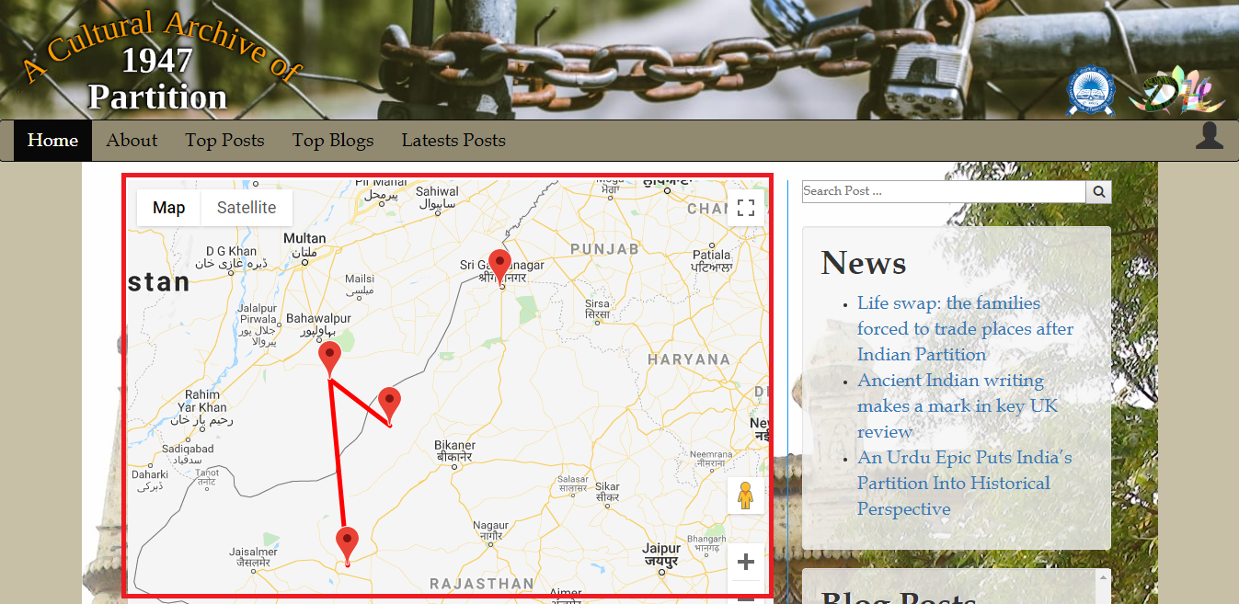
View Post
1. Sorted by Location

Slide 10
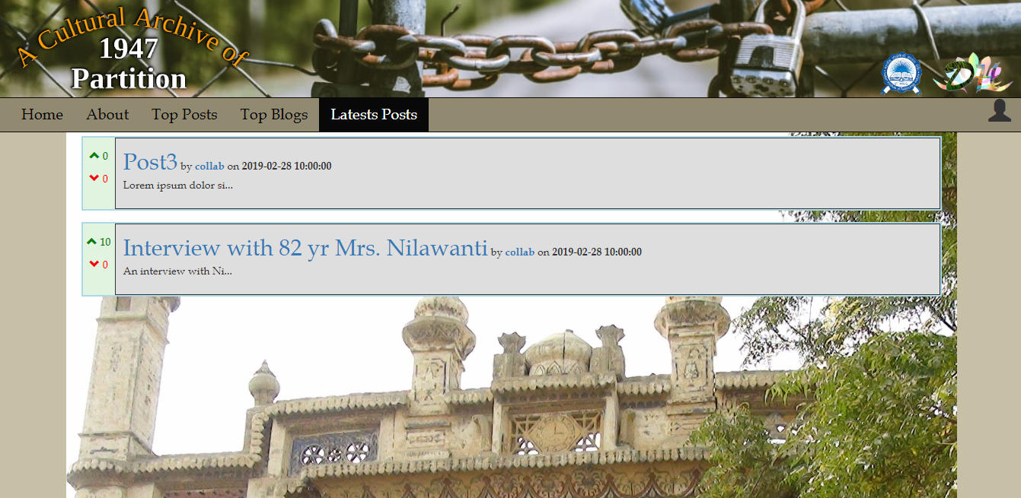
View Post
2. Sorted by New

Slide 11
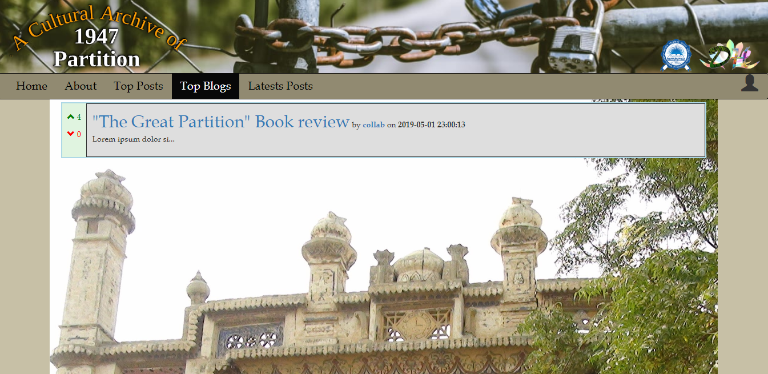
View Post
3. Sorted by Top

Slide 12
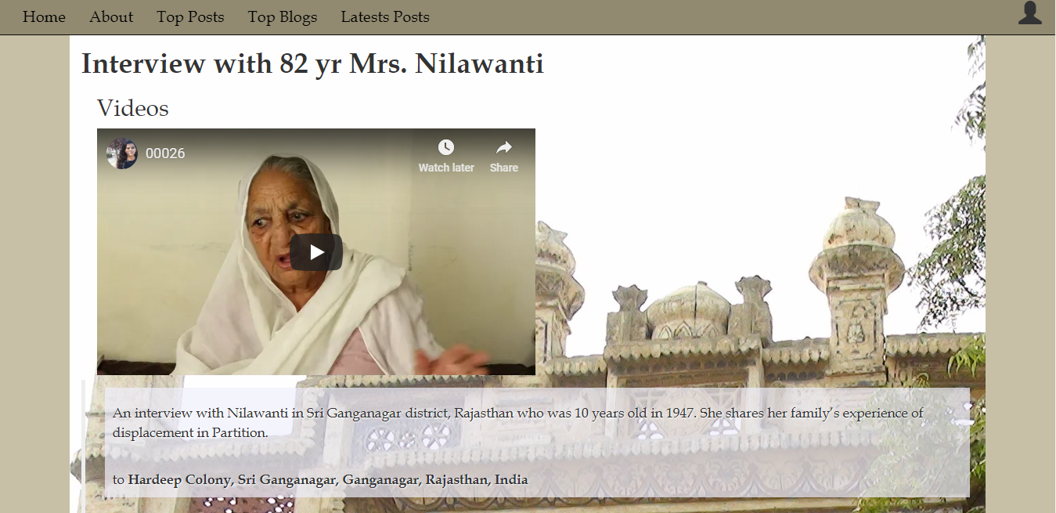
View Post
Structure of post

Slide 13
Make a Post
Paste make a post page

Slide 14
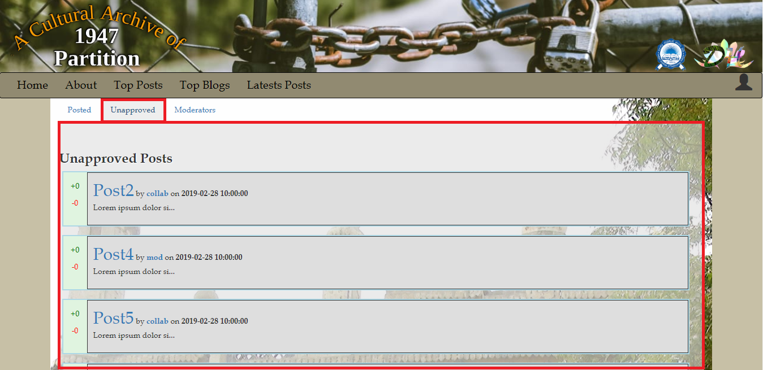
Approving Posts

Slide 15
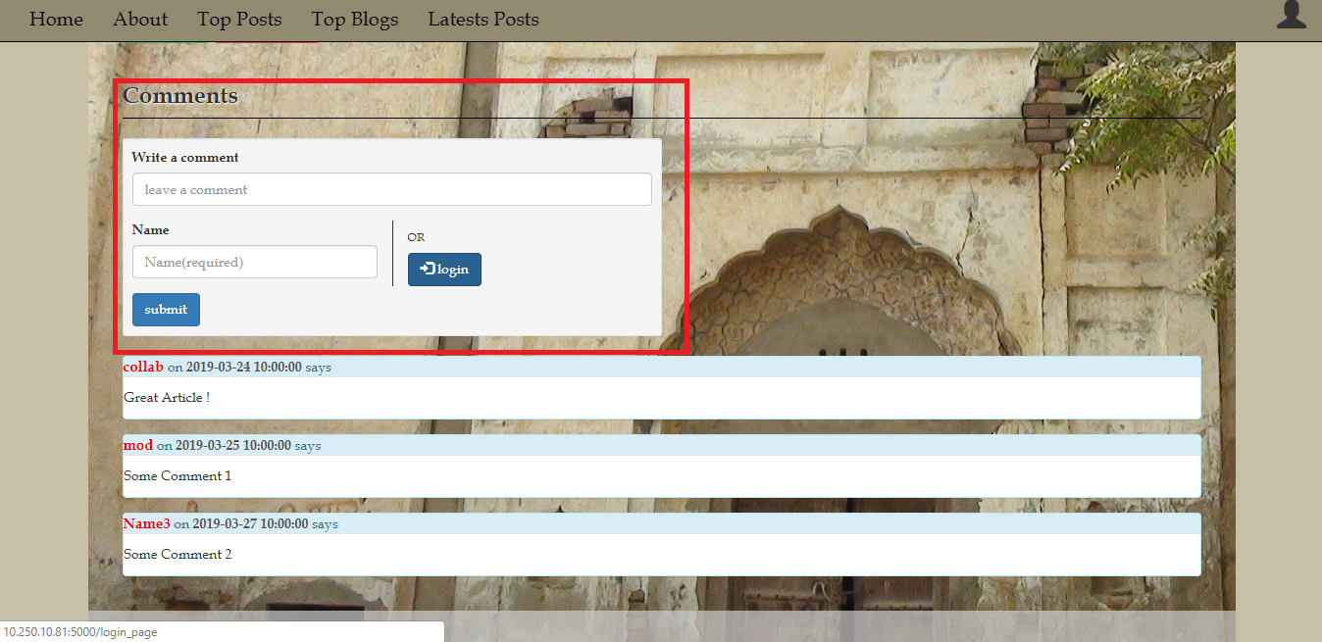
Posting Comments

Slide 17
DEMO
Lets see how it functions. Shall we...

Slide 18
THANKS!

